Slide 1
How to calculate the value of a property given the projected cash flows?
Necessary to calculate the expected return on a real estate investment
Notes:
Hello. In this video I will show you how to calculate the value of a property given the projected cash flows.
CLIC EN PANTALLA
This is necessary in order to calculate the expected return on a real estate investment.
CLIC EN PANTALLA

Slide 2
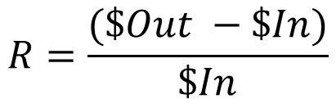
How to calculate the value of a property given the projected cash flows?
Return: Purchase at time 0 and Sale at time 1
Positive: Investment has been profitable
Change in price of an investment over time
Negative: investment has resulted in a loss of money
$$R=\frac{(\$Out −\$In)}{\$In}$$
Notes:
I will start by defining “return” through a simple two-period model : purchase at time 0 and sale at time 1.
CLIC EN PANTALLA Y APARECE EL TEXTO DEBAJO DE LA FLECHA DELGADA
Return, is the change in price of an investment over time, which can either be :
CLIC EN PANTALLA APARECE LA LLAVE Y EL TEXTO SUPERIOR
Positive, meaning that the investment has been profitable.
CLIC EN PANTALLA Y APARECE Y EL TEXTO INFERIOR
Or negative, meaning that the investment has resulted in a loss of money.
CLIC EN PANTALLA Y APARECE LA FÓRMULA
It is usually calculated as a percentage: Profit (the total money taken out of the investment minus the original total invested) divided by the total amount of money initially put into the investment.
CLIC EN PANTALLA

Slide 3
How to calculate the value of a property given the projected cash flows?
1
Price
Return
2
Money is made not when you sell but when you buy an asset
Once your purchase price is set, so is your expected return
Expected return is not completely in your control
Future cash flows dictated by the fluctuations of the market
Important to be prepared for unforeseen volatility in the market and your returns
Notes:
Now, two important observations:
CLIC EN PANTALLA Y APARECE CONTENIDO DEL NRO.1
Firstly, “Price” and “Return” are opposite sides of the same coin. As the price of an investment increases, the return decreases, and vice versa. An investor looking for a larger return from their investment has to pay a lower price in order to meet their required return.
CLIC EN PANTALLA Y APARECE CONTENIDO DEL NRO.2
Secondly, money is made not when you sell but when you buy an asset. This is because once your purchase price is set, so is your expected return.
CLIC EN PANTALLA Y APARECE BLOQUE DE TEXTO SUPERIOR - ANIMARLO
However your expected return is not completely in your control, as future cash flows are to a large extent dictated by the fluctuations of the market and so it is important to be prepared for unforeseen volatility in the market and your returns.
CLIC EN PANTALLA

Slide 4

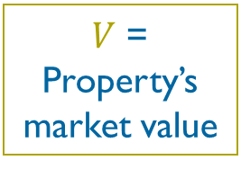

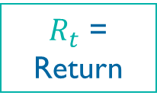
How to calculate the return if there is operational cash flow (rent) in addition to the reversion cash flow (sale)
$$R_{t}=({CF}_{t}+\left(V_{t}−V_{t−1}\right))/V_{t−1}$$
Example:
A property is bought for €200,000 at t=0
The landlord receives €7,000 rent and sells the property for €205,000 at t = 1
What is the rate of return?
$R_{t}$ = Return
$CF$ = Operational cash flow (rent)
$V$ = Property’s market value
$$R_{t}=(€7,000+\left(€205,000−€200,000\right))/€200,000$$
$$R_{t}=6.00\%$$
Notes:
Now. I will show you how to calculate the return if there is operational cash flow (rent) in addition to the reversion cash flow (sale).
CLIC EN PANTALLA
This is the equation:
Where Rt = return
CF = Operational cash flow (rent) and
V = property’s market value
Now, let’s complete the following example:
CLIC EN PANTALLA
A property is bought for €200,000 at t=0
The landlord receives €7,000 rent and sells the property for €205,000 at t = 1
In this case, what is the rate of return?
CLIC EN PANTALLA
EL EJERCICIO Y LA FÓRMULA APARECE AHORA EN LA PARTE SUPERIOR DE LA PANTALLA
According to the equation in this case we have:
Rt = (€7,000 + (€205,000 – €200,000))/ €200,000
So:
CLIC EN PANTALLA
Rt = 6.00%
CLIC EN PANTALLA

Slide 5
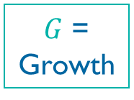

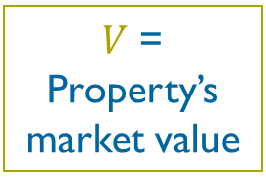
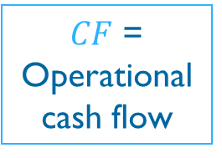

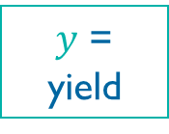
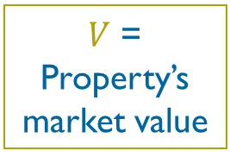
How to calculate the return if there is operational cash flow (rent) in addition to the reversion cash flow (sale)
Two components
Income
Return
Appreciation
Return
Cash flow derived from the rise in value of a property
Yield of an investment
$$y_{t}={CF}_{t} / V_{t−1}$$
$$G_{t}=(V_{t}−V_{t−1}) / V_{t−1}$$
$$€7,000 / €200,000=3.5\%$$
$$(€205,000 −€200,000)/€200,000=2.5\%$$
$y$ = yield
$V$ = Property’s market value
$CF$ = Operational cash flow
$G$ = Growth
$V$ = Property’s market value
Notes:
To understand better the previous equation I will break it down:
There are two components which combine to equal the total return of an investment:
CLIC EN PANTALLA Y APARECE SOLO EL GLOBO DE TEXTO IZQUIERDO
Income Return – which is the return made from the net operating income, and the…
CLIC EN PANTALLA Y APARECE SOLO EL GLOBO DE TEXTO DERECHO
Appreciation Return – which is the return made from the increasing market value of the property.
CLIC EN PANTALLA Y APARECE LA LLAVE DE INCOME RETURN Y SU BLOQUE DE TEXTO
The Income return is often referred to as the yield of an investment and can be expressed as such:
CLIC EN PANTALLA Y APARECE LA FÓRMULA ABAJO Y LA FÓRMULA APLICADA CON LAS LLAMADAS INDICANDO LO QUE SIGNIFICA CADA COMPONENTE.
yt = CFt / Vt-1 (Where y = yield, CF is the operational cash flow and V is the property’s market value)
Is important to investors who concentrate more on income than growth.
CLIC EN PANTALLA Y DESAPARECEN LAS LLAMADAS Y APARECE LA FÓRMULA DESARROLLADA ENCERRADA EN CELESTE
For example: €7,000 / €200,000 = 3.5%
CLIC EN PANTALLA Y APARECE LA LLAVE DE APPRECIATION RETURN Y SU BLOQUE DE TEXTO
Ant the Appreciation Return is the cash flow derived from the rise in value of a property, and can be expressed as such:
CLIC EN PANTALLA Y APARECE LA FÓRMULA ABAJO Y LA FÓRMULA APLICADA CON LAS LLAMADAS INDICANDO LO QUE SIGNIFICA CADA COMPONENTE.
G_{t} = (V_{t} – V_{t-1}) / V_{t-1} (where G = growth and V is the property’s market value)
Is important to investors who concentrate more on capital growth than income
CLIC EN PANTALLA Y DESAPARECEN LAS LLAMADAS Y APARECE LA FÓRMULA DESARROLLADA ENCERRADA EN CELESTE
For example: (€205,000 - €200,000) / € 200,000 = 2.5%
CLIC EN PANTALLA

Slide 6



How to calculate the return if there is operational cash flow (rent) in addition to the reversion cash flow (sale)
Total Return $=$ Income Return $+$ Appreciation Return
$$3.5\%+2.5\%$$
$$R_{t}=6\%$$
Notes:
So, as Total Return = Income Return + Appreciation Return
CLIC EN PANTALLA
Therefore, the total return is 3.5% + 2.5% = 6%
CLIC EN PANTALLA

Slide 7
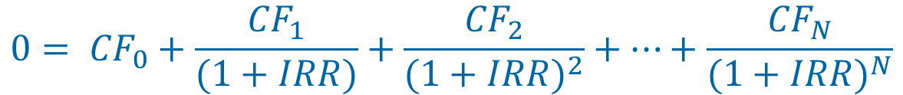
How to measure the return of a multi-period investment
Total return is typically measured over multiple time periods because real estate investment is normally long-term
Investors therefore need to calculate the expected long-term horizon of the investment
Internal Rate of Return – IRR:
Single rate that discounts all net cash flows obtained from the investment to a present value that equals the purchase price of the investment.
$$0= {CF}_{0}+\frac{{CF}_{1}}{(1+IRR)}+\frac{{CF}_{2}}{{(1+IRR)}^{2}}+…+\frac{{CF}_{N}}{{(1+IRR)}^{N}}$$
Notes:
Now that you know how to calculate the return of an investment over one period, I will show you how to measure the return of a multi-period investment.
CLIC EN PANTALLA
In the real estate sector, total return is typically measured over multiple time periods because real estate investment is normally long-term.
CLIC EN PANTALLA Y APARECE EL ÍCONO > Y EL TEXTO DE LA DERECHA
Investors therefore need to calculate the expected long-term horizon of the investment, and the following definition is widely employed:
CLIC EN PANTALLA Y APARECE EL BLOQUE DE TEXTO Y LA FÓRMULA
Internal Rate of Return or IRR is the single rate that discounts all net cash flows obtained from the investment to a present value that equals the purchase price of the investment.
CLIC EN PANTALLA

Slide 8
How to measure the return of a multi-period investment
Discounted Cash Flow (“DCF”) Approach
Income Capitalization Approach
(Cap Rate/Yield)
How much income an investment will generate over an infinite/perpetual stream of cash flows
Used to calculate the total return, including income return and appreciation return, of the investment
Property value = PV (present value) of all future cash flows
Only appropriate for finite horizon investment valuation (e.g. 7 years)
Property value = NOI1 / Capitalization Rate
Capitalization Rate:
Captures the opportunity cost of capital of an alternative but similar investment for the investor
Determined by comparing the cap rates of other similar properties in capital markets
NOI1 =
NOI a year after the initial investment
Notes:
There are two approaches to real estate valuation:
CLIC EN PANTALLA
The Income Capitalization Approach (Cap Rate/Yield) and the Discounted Cash Flow (“DCF”) Approach.
CLIC EN PANTALLA Y DESAPARECE EL BLOQUE DE TEXTO DE LA DERECHA
The Income Capitalization Approach is used to…
CLIC EN PANTALLA Y APARECE EL BULLET
calculate how much income an investment will generate over an infinite/perpetual stream of cash flows (cannot be used in finite horizon investment valuation), where…
CLIC EN PANTALLA Y APRECE LA FÓRMULA Y LLAMADA DE LA IZQUIERDA
Property value = NOI1 / Capitalization Rate (where NOI1 stands for the NOI a year after the initial investment)
CLIC EN PANTALLA Y LLAMADA DE LA DERECHA
The Cap Rate captures the opportunity cost of capital of an alternative but similar investment for the investor – it is determined by comparing the cap rates of other similar properties in capital markets.
CLIC EN PANTALLA
CLIC EN PANTALLA Y APARECE EL BLOQUE DE LA DERECHA
Meanwhile the Discounted Cash Flow (“DCF”) Approach is used to…
CLIC EN PANTALLA
Calculate the total return, including income return and appreciation return, of the investment.
CLIC EN PANTALLA
Property value = PV (present value) of all future cash flows, discounted at the required total rate of return (“discount rate”)
CLIC EN PANTALLA
It is only appropriate for finite horizon investment valuation (e.g. 7 years).
CLIC EN PANTALLA

Slide 9
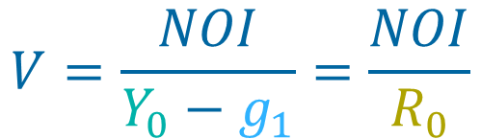
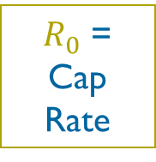
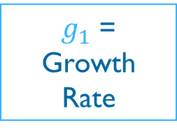
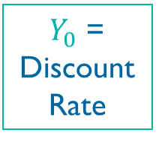
How to split the “cap rate” between the investor’s time discount rate and the property’s growth rate?
A real estate investment approximates a constant growth annuity:
$$V=\frac{NOI}{Y_{0}−g_{1}}=\frac{NOI}{R_{0}}$$
$Y_{0}$ = Discount Rate
$R_{0}$ =
Cap Rate
$g_{1}$ =
Growth Rate
Notes:
And finally, how do we split the “cap rate” between the investor’s time discount rate and the property’s growth rate?
CLIC EN PANTALLA
To the extent that a real estate investment approximates a constant growth annuity…
Where
CLIC EN PANTALLA Y APARECEN LAS LLAMADAS DE LA FÓRMULA
Y₀ = discount Rate, g_{I =} growth Rate, and R₀ = Cap Rate
Now, I will show you a valuation model where the two valuation methods are used to calculate the value of a property.
CLIC EN PANTALLA Y PASA AL SIMULADOR

